Slide 1

VaccineCo Growth Strategy for Africa’s Vision 2040
Team Lernaean Collective
A Quantitative & Qualitative approach towards growth strategies built on bankable demand base, import-parity corridor pricing and blended financing

Slide 2

→ Builds capacity, ensures affordable reliable supply, and creates a bankable growth platform for Vision 2040.
Executive Summary
A three-pillar strategy to scale VaccineCo for Africa’s Vision 2040
Bankable Growth Architecture
Accelerated Manufacturing Pathway
Tender-Winning Economics
Deliver early doses fast: fill & finish in ~15 months, API in ~24 months
Maximize capital efficiency: $10M to ~3× more doses vs API-first
Secure anchor demand: UNICEF pooled tenders, then selective bilateral
Price with transparency: indexable import-parity corridors hedge FX/freight
Cut the true cost driver: validated yield gains, dual-sourcing, optimized packaging
Differentiate on reliability: cold-chain partnerships for >95% OTIF
Make scenarios financeable: AMCs + base-volume agreements lenders underwrite
Lower WACC: pensions/DFIs blend to ~11.5% (from ~13.8%)
Free cash sooner: receivables programs cut WC cycle 50 to 40 days

Slide 3
Simple Strategy I: How we built the case (Data, Method, and Context)
Market context that matters
Where VaccineCo starts from
Demand is rising, supply is imported.
Africa consumes nearly a quarter of global vaccines yet imports the vast majority, creating a resilience gap and local-content opportunity.
Procurement is pooling and shifting to value.
Regional demand pooling and ‘Buy African’ preferences are growing; advance purchase commitments are being explored.
Reliability wins.
High unemployment and public-debt pressure in South Africa constrain fiscal space, so buyers favor predictable total cost and on-time supply.
We are uniquely positioned to execute due to:
Established Production: we operate a >10M dose fill-and-finish facility with the use of technology transfers.
Proven Market Access: We are an established supplier for government tenders and private channels in South Africa.
Regulatory Head-Start: Our South African headquarters provide the fastest vaccine approval pathway on the continent.
Our method
What went into the model
Data Intake
Demand, cost & operations datasets of various vaccines with various channels to at least 6+ countries consolidated into model
Cost & Value Engine
Landed cost vs. local cost per product and country; profitability and cash impact
Uncertain
Bear / Base / Bull paths for demand and financing & Speed to first lots
Demand by Program & country
Historical awards and forward views by UNICEF, pooled African procurement, bilateral government orders
Operations & Finances
Utilization, working capital days, profit and loss, and interest burden.
Import Landed cost per dose
Local Production & Capacity
Freight, duty, value-added tax, inland logistics, and expected spoilage.
Active ingredient, fill and finish, packaging, energy, cold-chain handling and capacity+
Primary objective
Secure financeable, resilient local vaccine capacity delivering pooled-contract volumes toward Africa’s Vision 2040.
Secondary objective
Lower unit cost and capital cost through API and yield gains, corridor pricing, and last-mile reliability.
Secondary Research We synthesized UN births, WHO coverage, UNICEF awards, CIF tariffs, tender data into Excel formulas validating demand, pricing, financing, corridors.

Slide 4
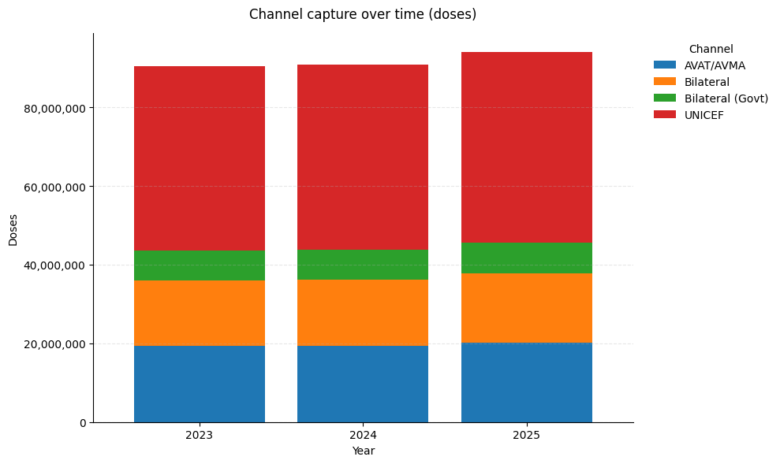
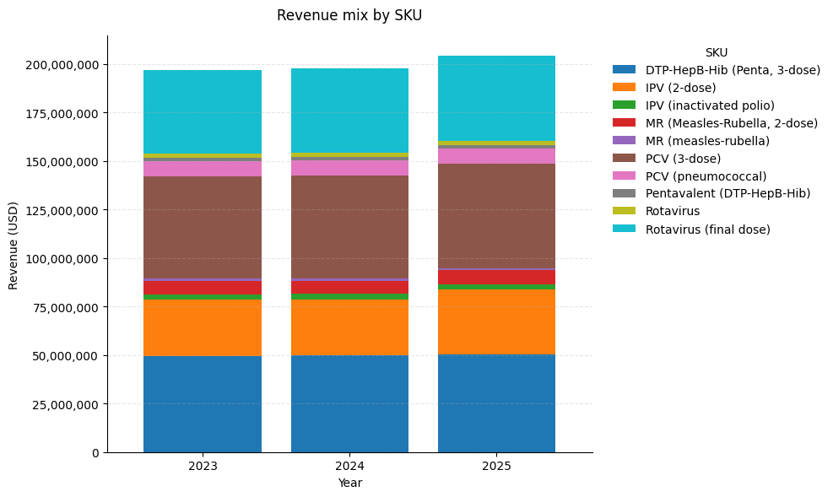
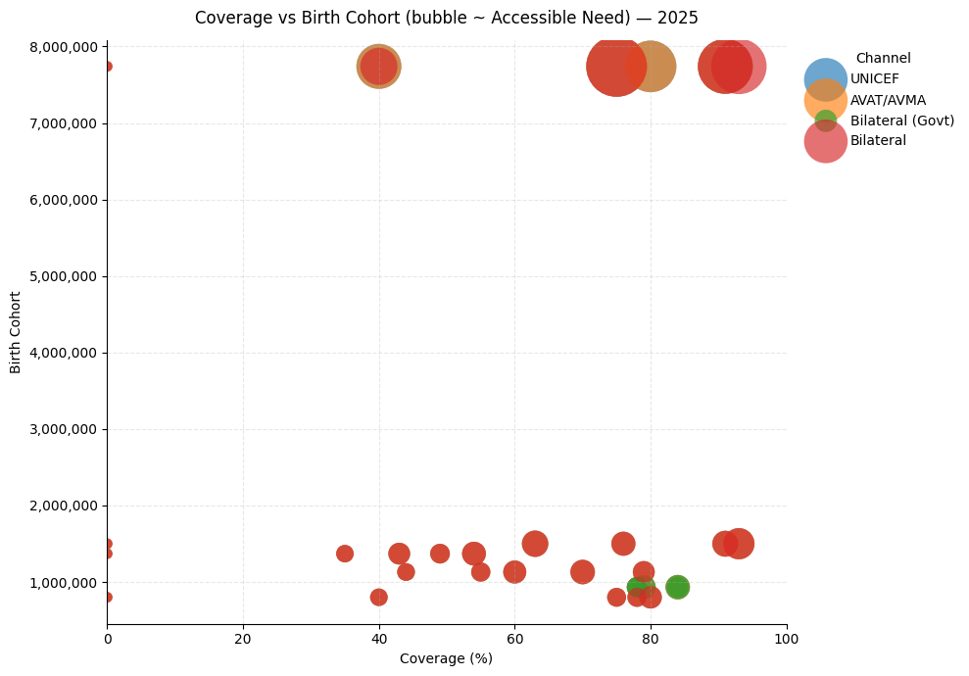
Simple Strategy II: Where the doses are (buys and scale)
Pooled procurement gives dependable base demand and big birth cohorts at high coverage convert fastest.
The United Nations Children’s Fund anchors the base volume each year, with African pooled procurement as the second growth engine.
The largest birth cohorts with high vaccination coverage are the fastest wins because programs are stable and forecasting is reliable. Entering through pooled tenders first and then add targeted bilateral tenders where delivery schedules and funding are dependable.
Our first three product types are aligned with these routine immunization pools to maximize line utilization and tender win-rate.
Each stacked bar shows total doses by channel. The red layer (United Nations Children’s Fund) is the largest every year; blue (African pooled procurement) grows; orange and green (bilateral) are smaller.
The height proves scale; the layers show why we build our offtake around pooled demand.
Tender timing and budget slippage
Exchange-rate shocks
Coverage can fall below averages
Challenges
Taking a scientific deep dive into money making with pinpointing exact vaccines;
Stacked bars show which product types pay the bills. Pneumococcal conjugate and the combined diphtheria-tetanus-pertussis-hepatitis B-Haemophilus influenzae type b vaccine dominate revenue.
This could be a focal point that the first three products types mirror routine immunization demand.
Each bubble is a country cell. Right and high means high coverage and big birth cohort. The largest bubbles in that quadrant are our ‘go-first’ cells because programs are stable and volumes lock in quickly.

Slide 5
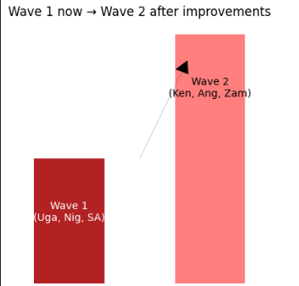
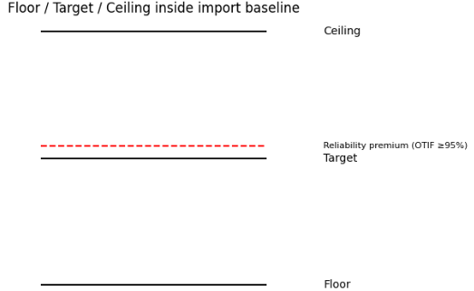
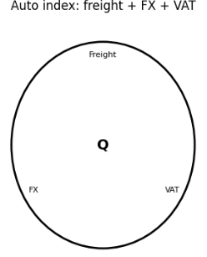
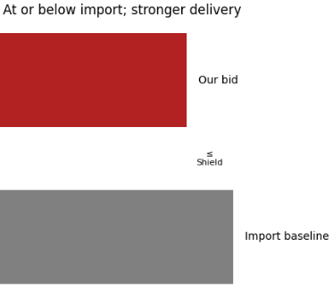
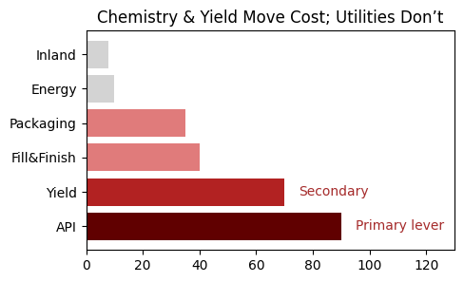
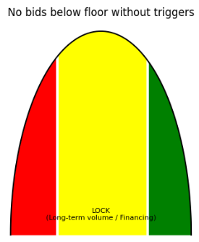
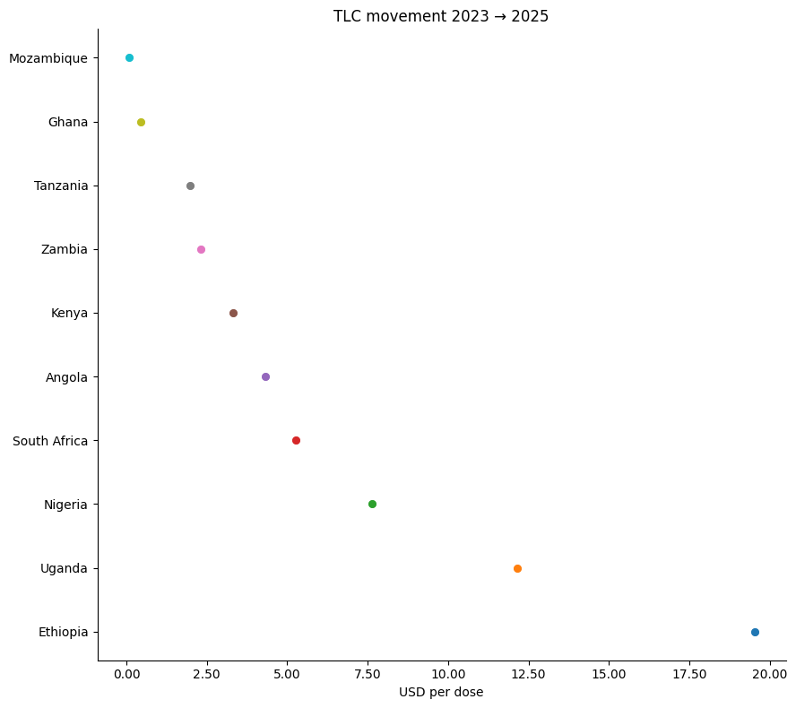
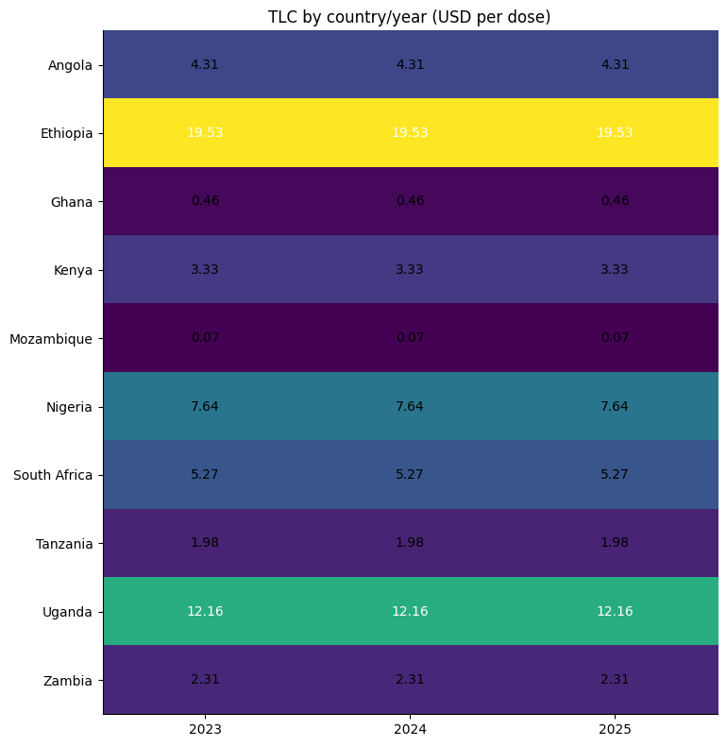
Simple Strategy III: Import Price Baseline
Sequence Markets by Difficulty
Example:
First wave: Ethiopia, Uganda, Nigeria, South Africa, where import costs are high to mid-high and parity is achievable. Second wave: Kenya, Angola, Zambia
Publish a transparent corridor for each country × product type.
We will show a floor, target, and ceiling tied to the country’s import number, plus a small premium for guaranteed delivery
Make the corridor bankable.
Every corridor will carry automatic quarterly indexation (freight benchmark, exchange-rate band, and value-added tax updates)
Use the baseline in negotiations.
In pooled tenders we will say plainly: “Our local offer is at or below your proven import cost, with stronger delivery performance and no currency risk on the government side.”
Focus the cost program where it changes outcomes.
Because inland transport barely moves the number, we put effort into active-ingredient sourcing and yield to reduce local cost.
Create internal guardrails.
We will not bid below the corridor floor unless (a) a long-term volume guarantee is signed, or (b) a financing instrument .
Import cost varies widely across countries. Most of the cost sits at the border rather than inland. Freight value at the border and value-added tax drive the number.
This cross-country picture is the reference for “fair price” corridors.
Relative positions matter for entry strategy. High-cost countries are easier to win at parity; very low-cost countries require a stronger value case or later entry.

Slide 6
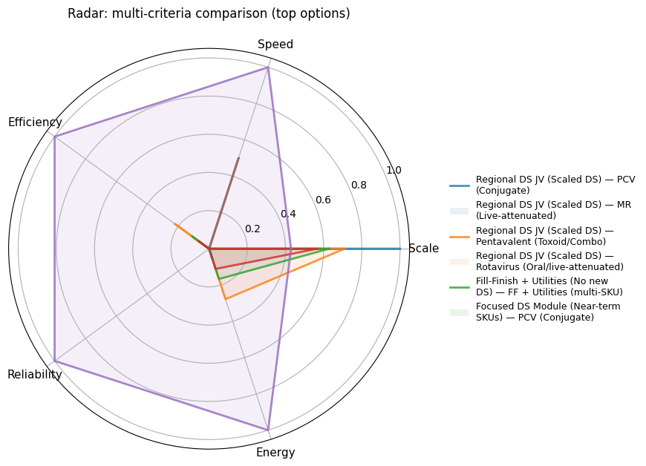
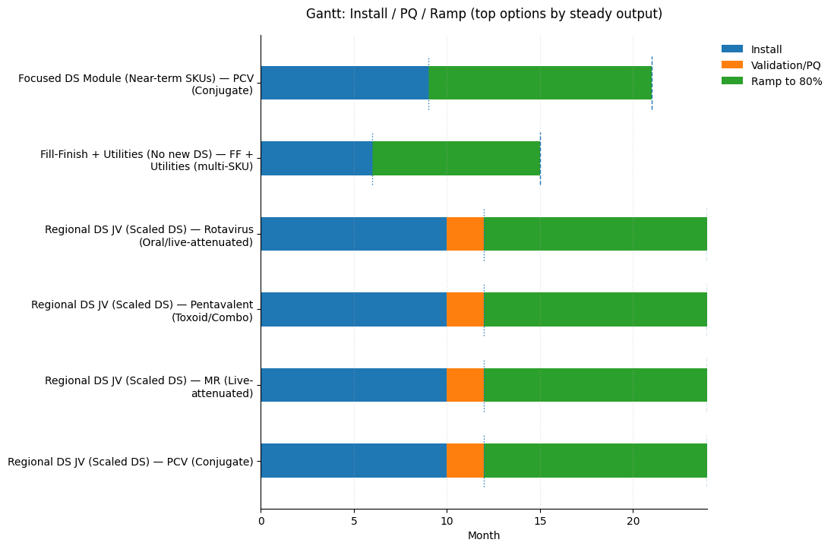
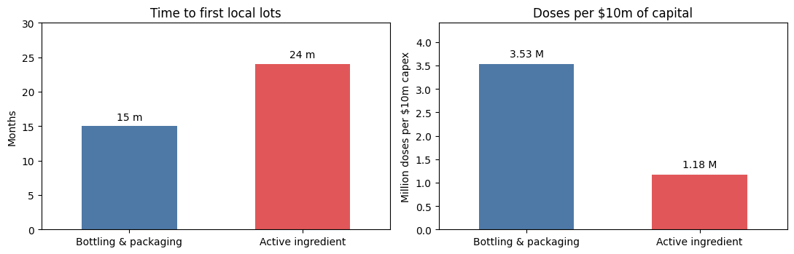
Quantitative Strategy I: Two-speed capacity, Deliver Now, Localize next
How we build: quick start now, full localization next
Strategy
We begin with bottling and packaging, so first local lots are released in about 15 months.
Example: Start making the active ingredient for the measles–rubella vaccine once two conditions are met: regulator approval and signed purchase commitments.
Start now with bottling and packaging and trigger the first active-ingredient module after qualification and pre-qualification are achieved and offtake is signed.
Bridge capacity wins on speed and cost: Bottling and packaging scores highest on speed and capital efficiency while remaining reliable, ideal for getting doses out early.
Second-phase plays: Pneumococcal and other complex vaccines bring bigger scale but slower timing and higher energy needs, plan them after the first module is running.
Fastest path: Bottling and packaging reaches first local lots in ~15 months, then ramps quickly to steady output.
Deeper build takes longer: Adding active-ingredient production through a regional joint venture adds ~6–9 months but delivers larger long-term capacity.
Time: 15 months to first lots for bottling and packaging vs ~24 months for the first active-ingredient module.
Capital productivity: Each $10 million builds ~3.5 million doses with bottling and packaging vs ~1.1–1.2 million doses with active-ingredient production.
Implication: Lead with bottling and packaging to deliver fast, low-cost doses, while preparing the active-ingredient module

Slide 7
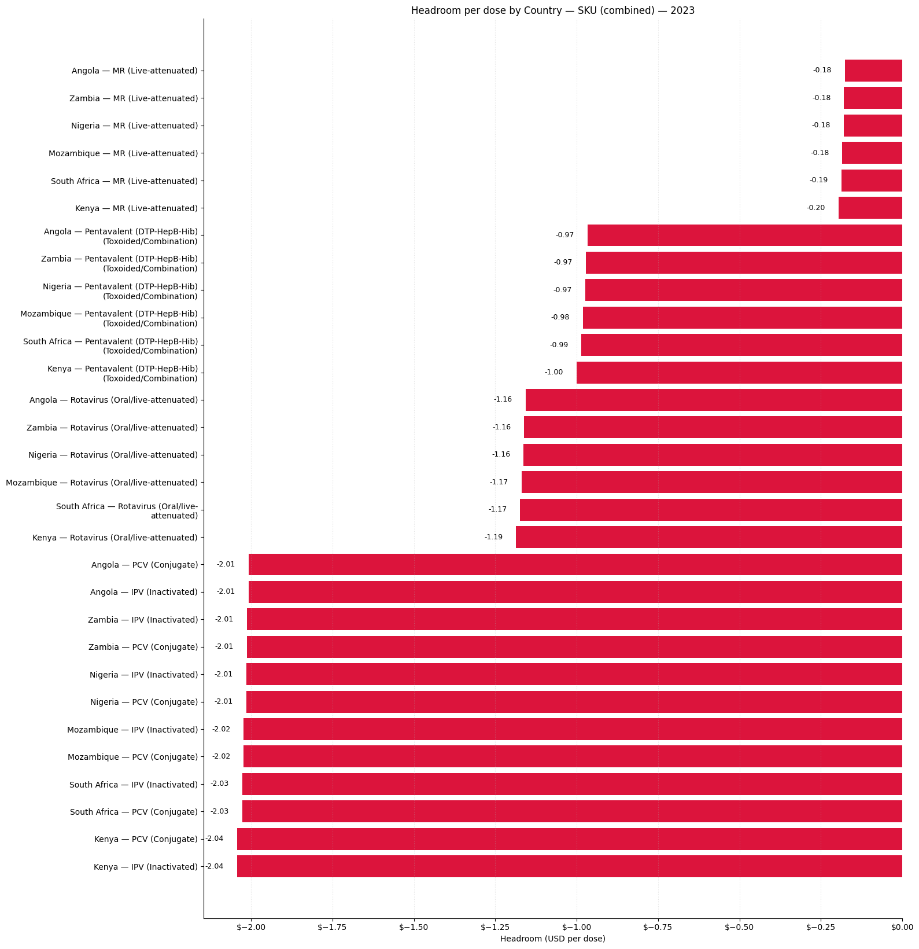
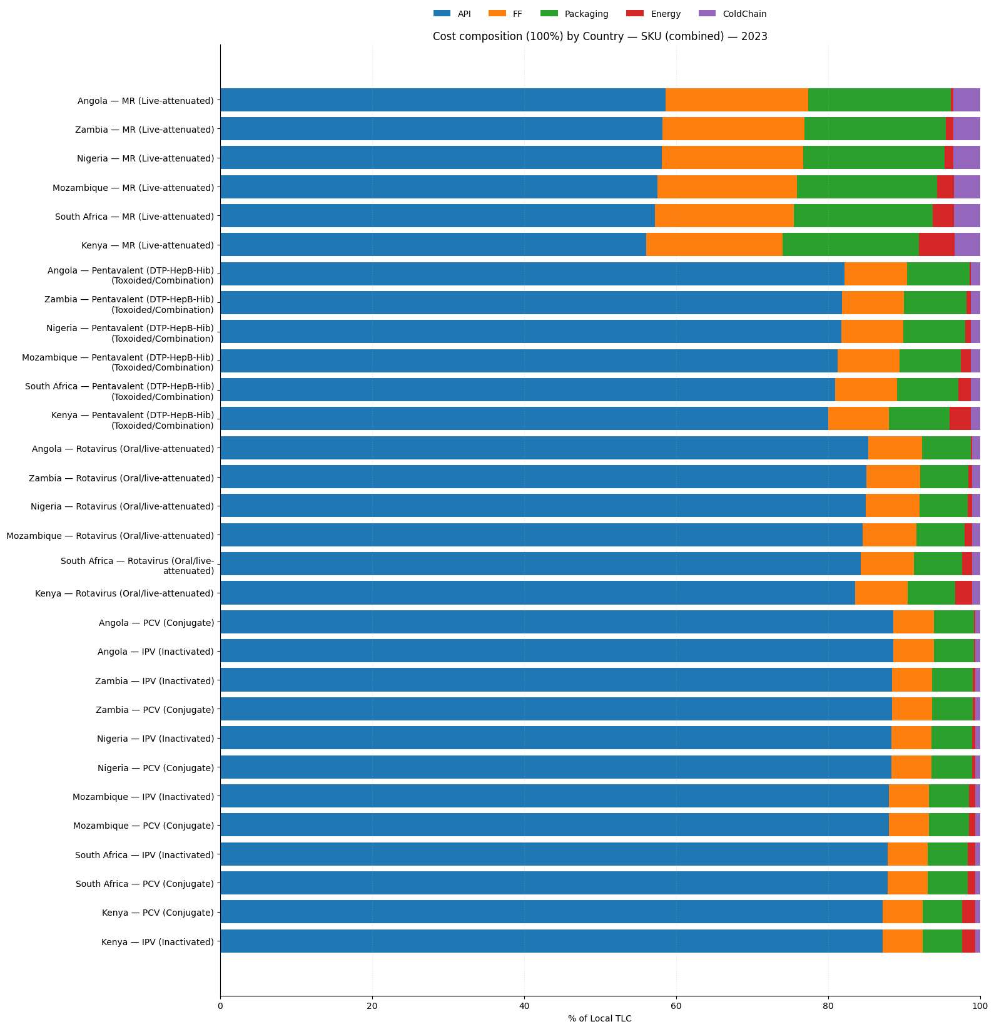
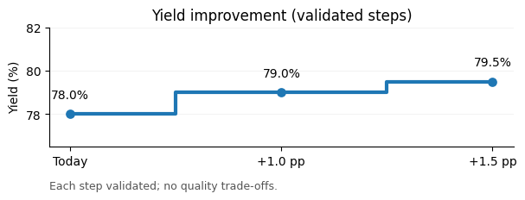
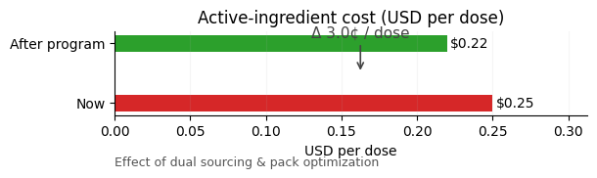
Quantitative Strategy II: Our Cost Position and the Path to Parity
Why local cost is high today and exactly how to close the remaining gap
Strategy
The active ingredient drives our unit cost; electricity and cold chain are small shares. Savings must come from chemistry and yield
To speak scientifically, Measles–rubella is our first parity target; the combination vaccine follows once yields step up. Conjugate and inactivated products move later when the economics improve.
Securing two qualified suppliers for the active ingredient, with volume commitments, right-sized pack formats, and delivery windows that cut waste.
Running lines at ninety percent or higher utilization and standardize materials as our goal is to reduce cost of sales
Yield program:
Batch-size upgrades, setup-time reduction, and statistical in-process controls (in-line analytics, tighter acceptance bands).
Validation gates every wave; no quality shortcuts, each gain is locked before moving up.

Slide 8
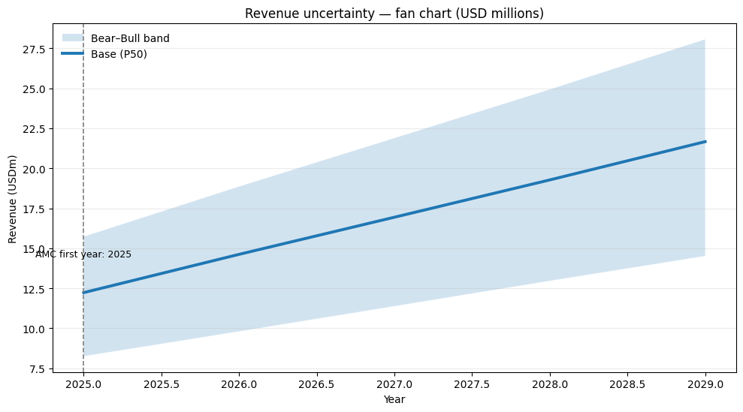
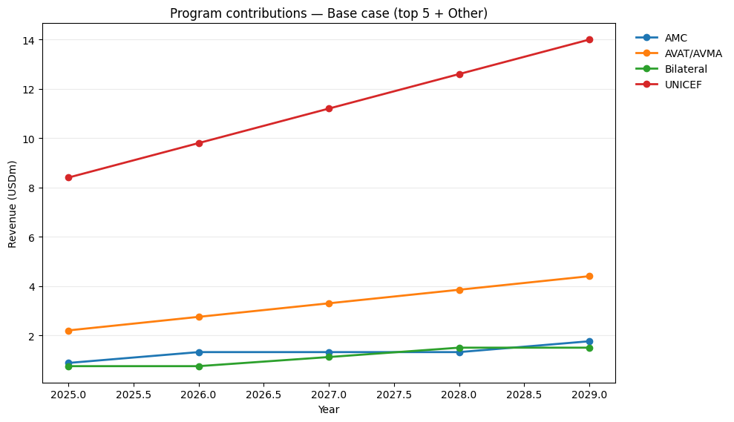
Quantitative Strategy III: Turn uncertainty into contracts (base, bear, bull)
Turning a probabilistic demand picture into contracted, financeable volume
Strategy
We sign base-volume agreements with the United Nations and African pooled procurement that match our first-phase capacity and release purchase schedules quarterly.
Adding advance-market-commitment clauses that unlock additional volume when we meet on-time-delivery and local-content milestones.
We keep bilateral tenders as a controlled top-up where demand forecasting is dependable, and payment terms are bankable.
This layered approach converts uncertainty into a clear P50 base and a staged upside, which lenders can underwrite.
Volumes and prices are refreshed annually using the corridor rules so budgets and contracts remain fair when freight or currency move.
The revenue fan chart highlights how layered contracts and corridor indexation narrow downside risk while preserving upside from milestone-triggered volume. The P50 trajectory demonstrates predictable growth that lenders can underwrite, while the bear–bull band reflects market volatility exposure.
Deal architecture
Milestones that unlock upside.
Protection on both sides.
Counterparty sequence.
Data discipline.
One master agreement per channel; country addenda list corridor prices, indexation rules, and milestone triggers.
On-time-in-full service level, certified fill-and-finish capability, and validated active-ingredient batches
Corridors are indexed to freight and currency so neither the buyer nor VaccineCo is exposed to external shocks
Lead with the United Nations for scale and payment certainty
Revenue distribution across procurement programs shows UNICEF as the anchor buyer, with AMC and pooled African channels gradually expanding. This diversification strengthens resilience, reduces dependency on a single buyer.

Slide 9
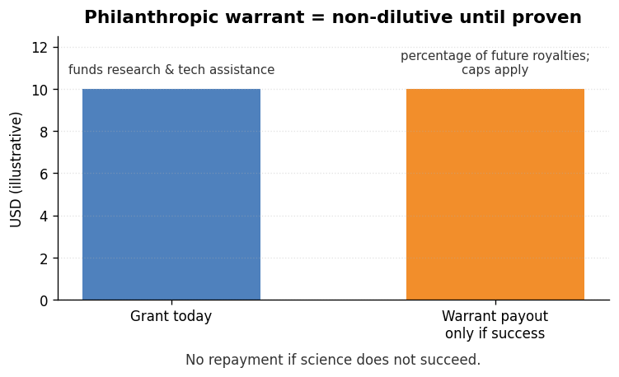
Qualitative Strategy I: Pathway Reverse Transfer & Philanthropic Warrant
Strategy
We will form a joint venture with a technology owner where VaccineCo contributes local distribution, public-buyer access, and quality systems in exchange for regional manufacturing and commercial rights.
Rights are ring-fenced to Africa with clear royalty sharing and a buy-down path as local-content milestones are achieved..
Philanthropic grantors fund targeted research with a warrant that pays out only if a product succeeds, keeping today’s cash needs low.
The near-term focus is process know-how that cuts active-ingredient cost and raises yield on measles–rubella; the medium term adds a novel platform candidate.
VaccintCo & Partner Value
Training & onsite experts
Regulatory execution
Access to pooled procurement
Clinical & stability data
Fill-finish at scale
Cold-chain & distribution
Process recipes & analytics
Royalty share declines as local content rises (starts higher → steps down at 30% / 50% / 70% local) Indicative: ~6–8% → ≈3%
Territory: Africa only. Governance: joint steering committee Data: reciprocal access for continuous improvement
Sequence innovation
First, lift measles–rubella yields and cut scrap to drop cost per dose.
Next, scale batch size and shorten changeovers on the combination vaccine.
Later, license one platform candidate with regional rights
Now — MR process uplift (yield ↑, scrap ↓, cost/dose ↓
Next — combo vaccine yield wave (batch ↑, changeover ↓)
Later — one platform candidate (license & regional rights)
Donor funds arrive now as a grant that pays for research and technical help.
If the program works, a capped warrant pays donors a small share of future royalties.
If it fails, there is no repayment, dilution, or debt.
From process uplift now to a platform candidate later

Slide 10
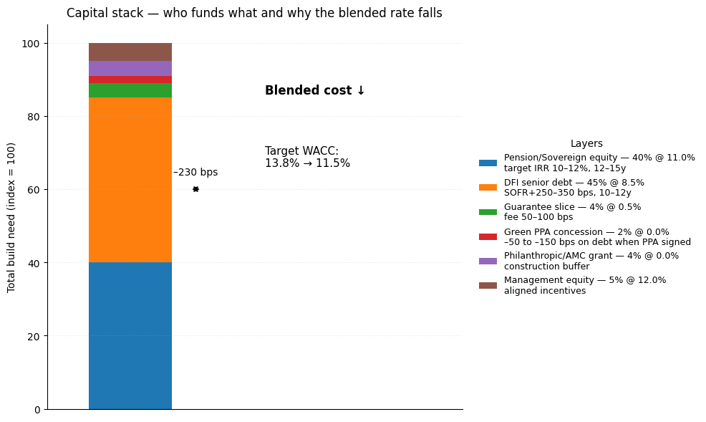
Qualitative Strategy II & III: Sovereign & Pension Anchor with Last-Mile Equity, Health-Economic
Strategy II Sovereign & Pension Anchor
We will pitch African sovereign wealth funds and national pension funds as infrastructure investors in health security with steady, long-dated returns.
Their capital anchors a blended stack with development-finance debt and guarantees; returns are matched to corridor-indexed offtake from public buyers.
A revenue escrow and hard covenants on on-time delivery protect investors and lower the risk price.
A green power purchase agreement cuts outages and helps reduce the cost of debt from development lenders.
Strategy III Last-Mile Equity, Health-Economic
We will acquire a minority stake in a specialist cold-chain company serving the Southern African region, with service-level guarantees tied directly to our on-time, in-full delivery target.
The stake secures transport and storage capacity in peak months, reduces spoilage, and creates an additional earnings stream from logistics services.
In tenders we will use a total-cost-of-ownership model that counts foreign-exchange risk, import duties, shipping and insurance, and the real cost of stock-outs to clinics.
Last Mile Equity & Health Economic further analysis in Appendix 5
Key Takeaways
This waterfall explains who funds the build and why the blended financing rate falls.
The base is domestic pension and sovereign wealth equity, about forty percent of the need, targeting an internal rate of return near eleven percent on twelve- to fifteen-year horizons.
Long-tenor senior debt from development finance institutions supplies roughly forty-five percent at about eight and a half percent.
A guarantee layer of around four percent reduces the risk premium on that debt. A green power purchase agreement adds a small concession that further lowers borrowing cost.
Working-capital days 50 - ≤40
Cash released
Interest saved
We free cash and cut interest drag while ramping. Cash released = (10 days ÷ 365) × annual cost of sale. Interest saved = cash released × average borrowing rate

Slide 11
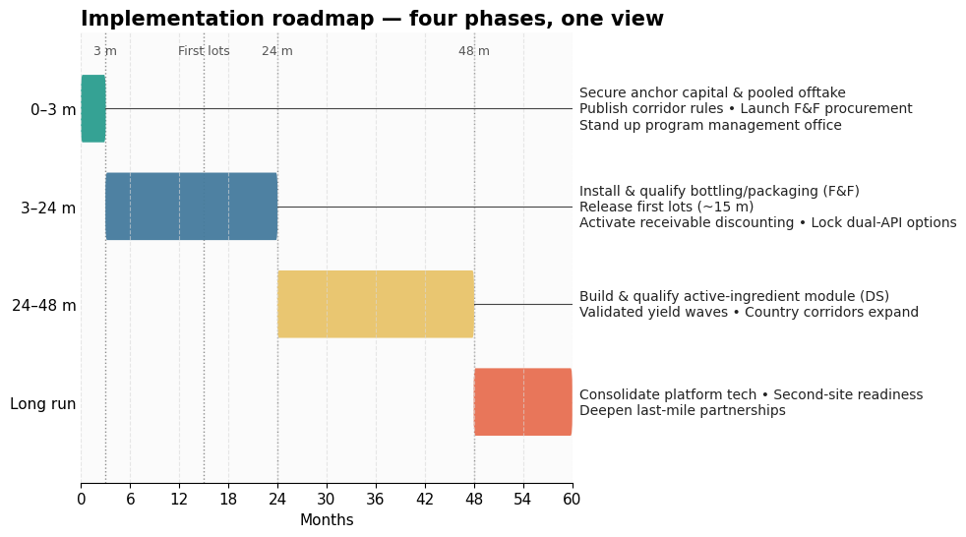
Implementation and plan of action
Months zero to three secure anchor capital and pooled offtake, publish corridor rules, launch procurement for bottling and packaging, stand up program management office.
Months 3 to 24 install and qualify bottling and packaging, release first lots, activate receivable discounting, lock dual active ingredient options.
Months 24 to 48 build and qualify active ingredient module, scale yields through validated waves, expand country corridors.
Long run consolidate platform tech, add second site readiness, deepen last mile partnerships.
Key risks and mitigations demand shortfall with AMC triggers, regulatory delay with early engagement, currency shocks with indexation, supply shocks with dual sourcing, outages with green power agreements, working capital strain with vendor managed inventory and escrow.
Final Overall Strategy & Recommendations
Build fast, localize next
Commission fill and finish for first lots within fifteen months while engineering drug substance modules to follow once yields and procurement confirm volumes enabling a staged path to full localization and earlier impact.
Price fairly, win reliably.
Publish transparent corridors per country and product anchored to import landed cost with automatic indexation and add a small earned premium for verified on time in full performance to lower total program cost.
Turn Demands into contracts
Convert probabilistic demand into bankable offtake by signing base volumes with pooled buyers then layering advance commitment triggers tied to delivery and local content milestones so lenders underwrite the ramp confidently.
Cost engine: active ingredient and yield
Attack unit cost through dual sourced active ingredient contracts pack size optimization and validated yield improvements with statistical controls and setup reductions locking each gain before scaling batch sizes and utilization.
From probability to paper Institutionalize corridor rules payment security and purchase schedules through memoranda of understanding that refresh annually ensuring budget certainty for buyers while transforming scenarios into enforceable agreements financiers recognize and fund.
Domestic capital as foundation
Invite sovereign wealth and pension funds as anchor equity alongside development finance debt and guarantees aligning national missions with stable returns while reducing currency exposure and lowering the blended cost of capital.
Cash conversion while we ramp
Discount receivables from United Nations agencies and regional pooled programs and operate vendor managed inventory in two hubs to reduce working capital days to forty or less saving interest and funding operations internally.
Leapfrog through reverse technology transfer Partner with a technology owner through a joint venture where VaccineCo provides distribution regulatory execution and fill finish capability in exchange for regional rights and milestone-based royalties supported by philanthropic research warrants.
Own the last mile and sell total cost Take a minority stake in a specialist cold chain operator to secure peak capacity cut spoilage and guarantee service levels then win tenders using total cost models proving lower overall program expense.

Slide 12
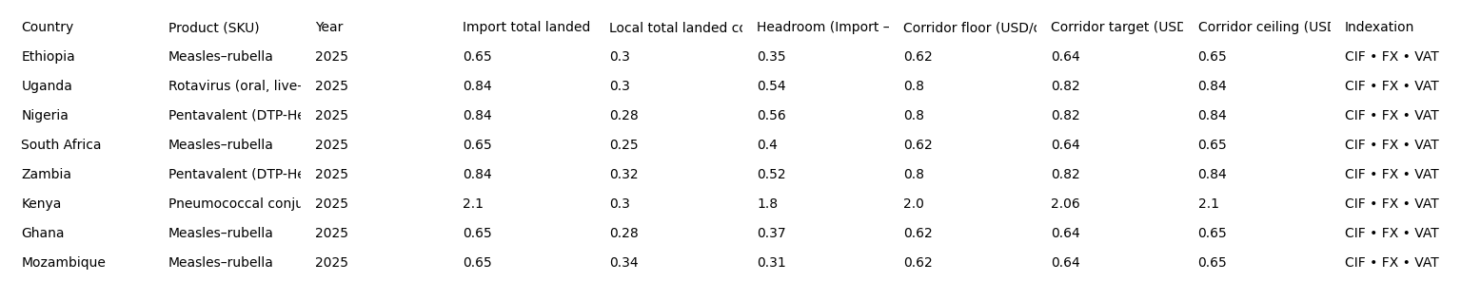
Appendix 1 Corridor math (country × SKU) The Numbers “fair price”
Our bids sit inside each country’s import total landed cost and automatically update for cost, insurance, and freight, foreign exchange, and value-added tax. A two to three cents per dose reliability premium is added only when on-time-in-full delivery is at least ninety-five percent.
Formula Box Import total landed cost = (cost, insurance, and freight per kilogram × dose weight in kilograms × (1 + value-added tax rate)) + inland logistics cost Local total landed cost = active ingredient + fill-and-finish + packaging + energy + cold-chain handling − subsidy + benefit Headroom = Import total landed cost − Local total landed cost Corridor = Floor (three to five percent below import) · Target (one to two percent below import) · Ceiling (equal to import)
We publish the corridor and its indexation rules in every tender. The reliability premium of two to three cents per dose is charged only when on-time-in-full delivery is at least ninety-five percent; otherwise it is not charged.

Slide 13
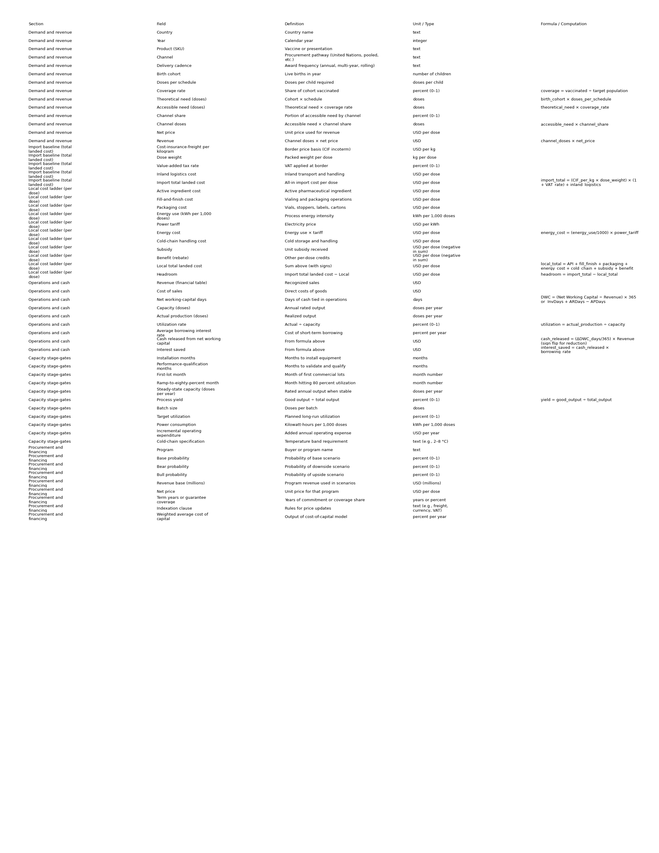
Appendix 2 Model formulas and data dictionary
Formulas
Accessible need (doses) = Birth cohort × Doses per schedule × Coverage rate
Channel doses (doses) = Accessible need × Channel share
Revenue (United States dollars) = Channel doses × Net price (United States dollars per dose)
Import total landed cost (United States dollars per dose) = Cost-insurance-freight per kilogram × Dose weight in kilograms × (1 + Value-added tax rate) + Inland logistics cost (United States dollars per dose)
Local total landed cost (United States dollars per dose) = Active ingredient cost + Fill-and-finish cost + Packaging cost + Energy cost + Cold-chain handling cost − Subsidy + Benefit (rebate)
Headroom (United States dollars per dose) = Import total landed cost − Local total landed cost
Corridor floor (United States dollars per dose) = Import total landed cost × (1 − 0.03 to 0.05)
Corridor target (United States dollars per dose) = Import total landed cost × (1 − 0.01 to 0.02)
Corridor ceiling (United States dollars per dose) = Import total landed cost
Cash released from net working capital (United States dollars) = (Change in working-capital days ÷ 365) × Cost of sales
Interest saved (United States dollars) = Cash released × Average borrowing interest rate Weighted average cost of capital (percent) = Σ [ Capital weight × Capital cost ] across: equity, development-finance-institution debt, guarantee effect, and power-purchase-agreement concession

Slide 14
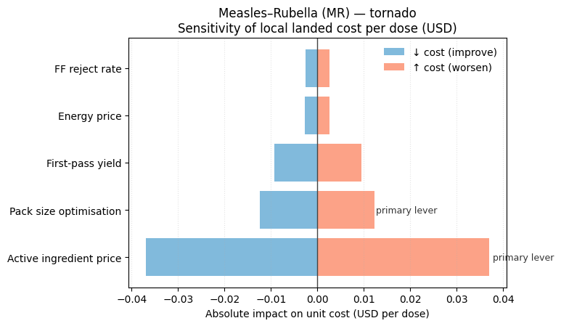
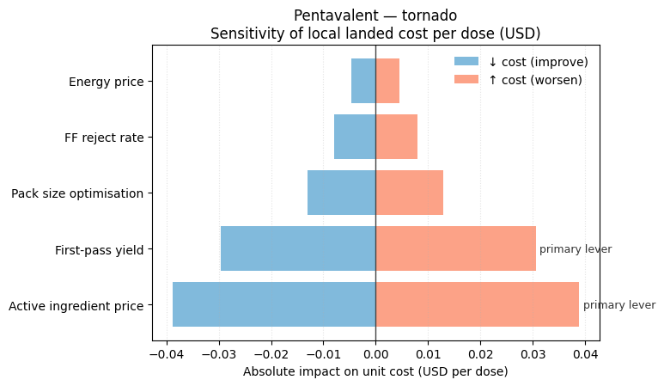
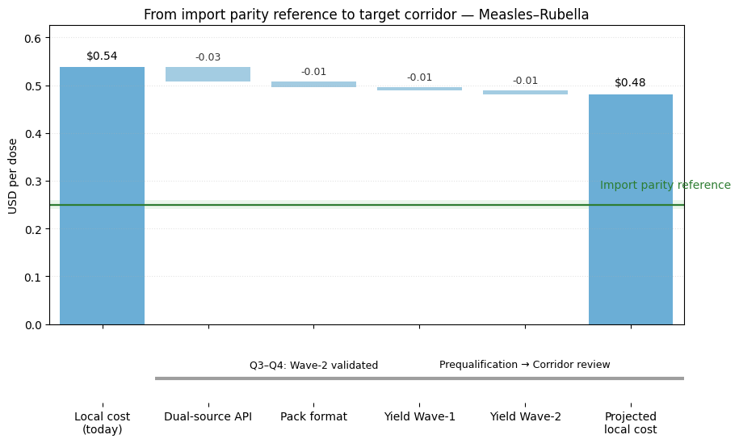
Appendix 3 Active-ingredient & Data sources
The waterfall steps our local cost down through three practical levers. We dual source the active ingredient and right size pack formats to cut open vial waste. Running two validated yield waves with one to one and a half percentage point gains each. These steps permanently lower scrap and improve unit economics. The two tornado charts quantify sensitivity and we can see unit cost is driven mainly by the active ingredient. First pass yield is the next strongest lever. Fill and finish rejects and energy prices have smaller effects. We apply the same playbook to the combination vaccine next to cross parity.
Driver | Baseline (example) | Test range used in charts | Why it matters
Active ingredient price per dose | from Local Cost | ± 0.03 United States dollars | Dominant share of unit cost for both exemplars
First-pass yield | from Operations | ± 1.5 percentage points | Converts fixed/labour into output; reduces scrap
Fill-and-finish reject rate | from Quality logs | ± 0.5 percentage points | Direct scrap and rework driver
Pack format (dose per vial) | current mix | effect ± 0.01 United States dollars | Components and open-vial wastage
Energy price | tariff today | ± 20 percent | Reliability issue > cost issue
Data sources we rely on
Immunization coverage and cohorts: World Health Organization / United Nations Children’s Fund Estimates of National Immunization Coverage (WUENIC) and United Nations World Population Prospects (births and population).
Import reference (cost, insurance and freight values; definitions): World Integrated Trade Solution (World Bank) and United Nations Comtrade guidance.
Taxes and value-added tax rates: KPMG Indirect Tax rates by country (and equivalent professional tax summaries).
Vaccine prices and procurement context: United Nations Children’s Fund Supply publications and vaccine price datasets.
Wastage and effective cold-chain practice: World Health Organization guidance on monitoring vaccine wastage and Effective Vaccine Management.
Advance Market Commitment precedent and blended finance context: Gavi Pneumococcal Advance Market Commitment, Afreximbank financing notes, and International Finance Corporation press releases on health and local-currency financing.

Slide 15
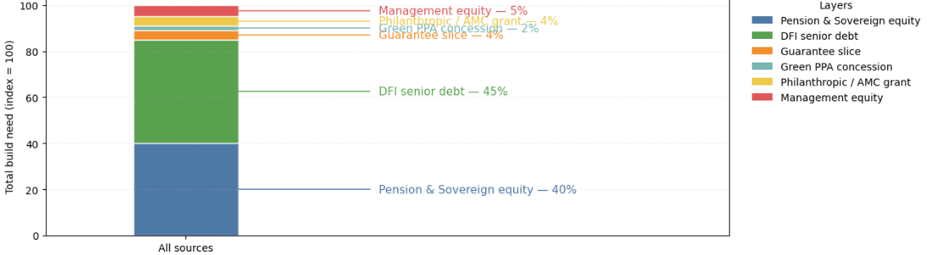
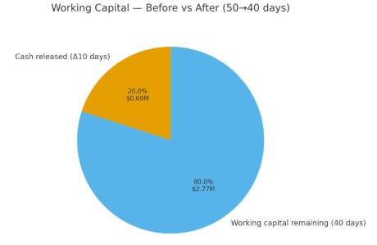
Appendix 4 Financing term-sheet and Cash Engine
Capital stack that truly lowers the price of money
We anchor equity with domestic pension and sovereign funds at about forty percent targeting ten to twelve percent returns over twelve to fifteen years because they view the facility as essential health infrastructure. We add development finance institution senior debt at about forty five percent and roughly eight- and one-half percent interest with ten to twelve year tenor so debt duration matches public offtake.
Why the blended rate falls and stays bankable
This mix is designed to move the weighted average cost of capital from roughly thirteen point eight percent toward about eleven point five percent which is a reduction of about two hundred and thirty basis points. The fall comes from cheaper domestic equity expectations, development finance pricing, and the guarantee effect, then the green power purchase agreement increases availability which further improves lender terms. Corridor indexation to freight exchange and value added tax creates predictable cash flows.
How cash is freed while the lines scale
Using the latest operations sheet the cost of sales in twenty twenty four is about twenty five point two five two million dollars. Cutting working capital from fifty days to forty days releases about zero point sixty nine million dollars because ten divided by three hundred sixty five multiplied by twenty five point two five two million equals that result. At a twelve percent borrowing rate this saves roughly zero point zero eight three million dollars per year. We achieve the reduction through receivable discounting from United Nations and pooled programs
Layer | Share of funding | Cost/return | Tenor | Purpose
Pension and Sovereign equity | 40% | 10–12% | 12–15y | Domestic anchor; stability
Development finance institution senior debt | 45% | ~8.5% | 10–12y | Long-dated debt
Guarantee slice | 4% | 0.5% fee | n/a | Risk reduction
Green power purchase agreement concession | 2% | 0.00% | n/a | Rate shave via availability
Philanthropic or Advance Market Commitment grant | 4% | 0.00% | n/a | Buffer for milestones
Management equity | 5% | ~12% | long | Alignment

Slide 16
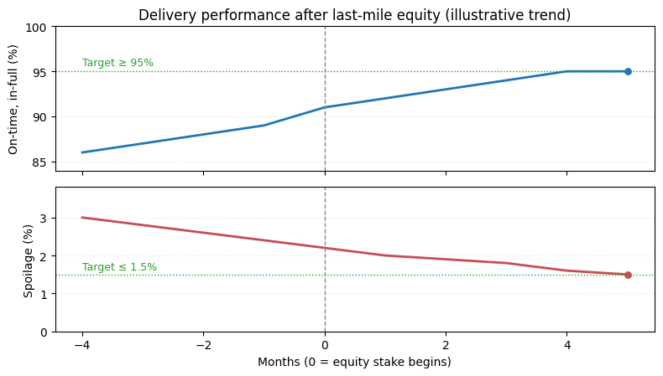
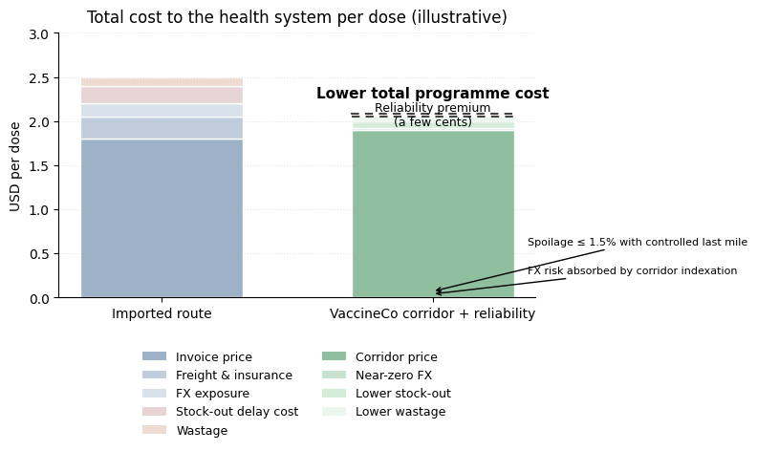
Appendix 5 Last Mile Equity
Trendlines show the operational effect of taking an equity stake in last-mile delivery. After month zero, on-time-in-full rises from about eighty-six percent to at least ninety-five percent as control capacity, telemetry, and pre-positioning. Spoilage falls from roughly three percent to near one-and-a-half percent, meeting our reliability targets consistently.
Stacked bars compare the real programme cost per dose. Imports include invoice price, freight and insurance, foreign-exchange exposure, stock-out delay costs, and wastage. Corridor price adds a small reliability premium but removes currency risk and spoilage.
Thank you !

